Slide 1
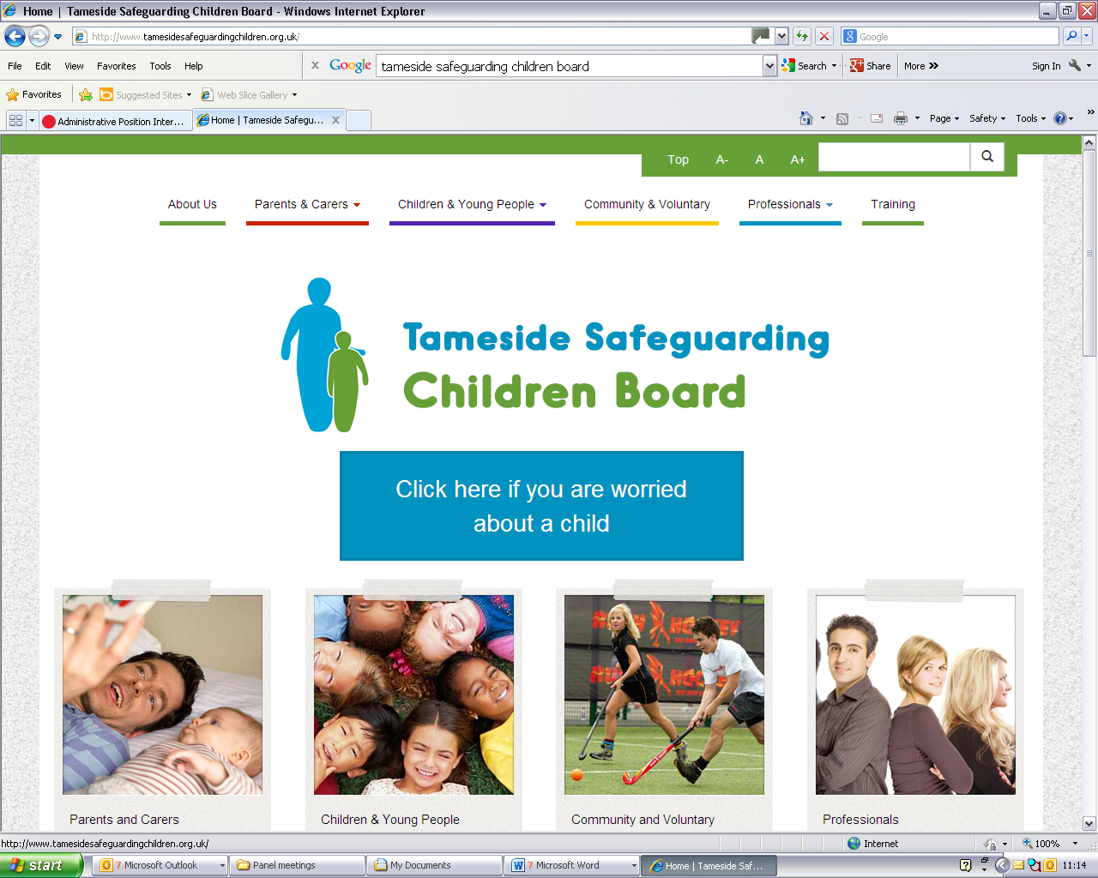
Safeguarding Practice Update
Assessment in Safeguarding Children

Slide 2
Aims of Session
To Consider :
Effective Assessment in Safeguarding Practice
Key Skills in Assessment
OFSTED Research into Assessment 2015
Practice Pitfalls and Tips
Developing a Practitioner Toolkit

Slide 3
Assessment is Key…
‘ Without effective assessment all that follows is impaired’
OFSTED Report
‘Quality of Assessment for Children in Need of Help’ August 2015

Slide 4
Assessment is…
‘An opinion or a judgement about somebody/something that has been thought about very carefully’
‘An evaluation – how good is something?’
‘The act of judging or forming an opinion about someone/something – an examination’

Slide 5
Assessment is easy…
Exercise
Pair up with someone you don’t know
Talk for 5 minutes about who you are, what you do and why you have come today

Slide 6
What do you know….
Name, gender, age, race, language, accent, demeanour, communication style, confidence, class, what they do and why they are here
Anything else?

Slide 7
Assessment
Informal assessment happens constantly and can be beneficial
We can learn a lot in a very short time
Sometimes we make an early assessment and only see evidence to support that
A more detailed, structured assessment will provide a wider picture rather than a snapshot
We will gather information and facts, make judgements and assumptions

Slide 8
Safeguarding Assessment
We use the same core skills whenever we assess – often unconsciously
We bring specialist knowledge and skills to assessment of children, young people and their families
Assessment tools and formats can help in formal assessments
Risk assessment can be challenging as it involves prediction based on history

Slide 9
Safeguarding Assessment
There is a high level of responsibility involved in assessing children’s needs and the risks they face – the stakes are high
Understanding child development; attachment; resilience and vulnerability; the voice of the child; parental engagement and capacity for change are all key elements in safeguarding assessment

Slide 10
How was it for you?
Think of a time when you underwent an assessment, it could be a health check, an interview a driving test….
What was good about the assessment?
What was negative?
What might have made it a more positive and more effective as an assessment?

Slide 11
Key Skills in Assessment
What do we do when we assess?
What are the key skills we employ?

Slide 12
Assessment Skills
Observing, listening, affirming, encouraging, engaging, reassuring, giving feedback, sharing, reflecting, summarising, analysing, checking understanding and meaning, applying perspective, asking questions, being honest and open, role modelling, respectful challenge, sorting facts from opinions …
Using knowledge & research evidence to make judgements and draw conclusions about need and risk based on your assessment

Slide 13
Assessment is…
Multi-faceted
Dynamic not static
Enhanced by joint work/discussion/critical reflection
Aided by use of assessment tools and formats
Inevitably subjective as a human process
A guided conversation
Potentially therapeutic in itself

Slide 14
OFSTED Report - Findings
Overall quality of assessments had improved
Robust leadership is a fundamental factor in ensuring good quality assessments
So is a ‘theoretical model of practice’ -leadership, supervision and use of consistent, shared assessment tools
Assessments were more effective when help was offered to families during the process

Slide 15
OFSTED Findings
Positive assessments contained the views of the parents and child – involvement
Manageable caseloads and good partnership working aided effective assessment
Committed leadership, supervision, training and development enhanced staff performance in assessment
Tools helped – for e.g. Family CAF

Slide 16
Some Pitfalls in Assessment
Assessments not always shared with families
Jargon and acronyms reduced family understanding
Families do not always understand what needs to change and why
Extended family views not reflected
Ability of parents to change not evident
33% of plans based on assessment were not clear and robust enough to drive improvement

Slide 17
How to improve Assessment
Child’s timescale should set the pace
Use of chronologies, history and analysis of findings to inform realistic plans
Involve families fully in assessment
Keep assessments live and dynamic
Support assessors via reflective supervision, training and development
Use evidence based tools and formats
Audit assessments and outcomes

Slide 18
Analysis
Analysis involves
‘Detailed examination of the elements or structure of something’ for example statistical analysis
‘The process of separating something into its constituent elements – synthesis’
Assessment = Measurement

Slide 19
Analysis
A robust , holistic assessment will gather relevant information, summarise it and analyse what that information means.
Analysis involves the weighing of evidence based on assessor’s knowledge & skills
The assessment is based on what we are told, what we observe, what we hear, historical information and what others tell us. From this a professional judgement has to be made about needs & risk

Slide 20
Practitioner Toolkit
Single & multi-agency assessment is enhanced by use of effective, shared tools and formats
OFSTED report cited Signs of Safety, Graded Care Profile, CAF and Single Assessment Framework as proven tools
Tameside Practitioner Toolkit is being developed and will be available on the TSCB website

Slide 21
Practitioner Toolkit
The toolkit will contain assessment tools/frameworks and models with guidance in their use
TSCB Training is available in the use of
Graded Care Profile Workshops – tool for assessing parental neglect
Whole Family Approach to Domestic Abuse is exploring use of a number of tools
Family CAF is promoted in all TSCB Training

Slide 22
What else could support you?
Please suggest any other ways in which practitioners could be supported to conduct consistently effective assessments.
What do you need as practitioners to enhance your assessment skills and practice?
What would be helpful?

Slide 23
Research Evidence
Local – look at the learning from Tameside Reviews via 7 minute Briefings & Top 10 Tips e.g. Respectful Challenge
All can be found on the TSCB Website www.tamesidesafeguardingchildren.org.uk
Use NSPCC CASPAR & INFORM briefings – regular briefings with high quality information about safeguarding practice
OFSTED Report 2015

Slide 24
Enhance your assessment skills ..
Practice – rehearse and build upon the multiple skills you already have
Use tools to help you – the simplest of tools will give you a framework and help you in preparation and reflection.
Co-work – joint assessment; discussion & critical reflection with supervisors and colleagues
Explore what works, adapt tools if it aids the process

Slide 25
Next Safeguarding Updates
Dates:
24th November 9:30 – 12:00
Child’s Needs Framework – Update and Impact on Practice
28th January 9:30 – 12:00
Working with Children where there is Neglect

